Slide 1
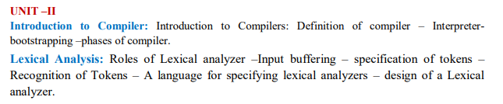
Compiler design

Slide 2
Introduction to compiler:
A compiler is a translator that converts the high-level language into the machine language.
High-level language is written by a developer and machine language can be understood by the processor.
Compiler is used to show errors to the programmer.
When you execute a program which is written in HLL programming language then it executes into two parts.
In the first part, the source program compiled and translated into the object program (low level language).
In the second part, object program translated into the target program through the assembler.

Slide 3
Definition of compiler:
A compiler is a software program that follows the syntax rule of programming language to convert a source code to machine code.
It cannot fix any error if present in a program; it generates an error message, and you have to correct it yourself in the program's syntax.
If your written program is correct (contains no error), then the compiler will convert your entire source code into machine code. A compiler converts complete source code into machine code at once. And finally, your program get executes.

Slide 4
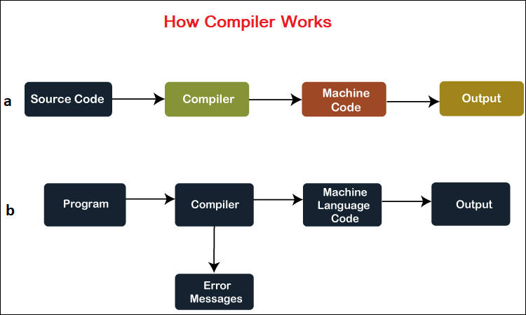

Slide 5
The entire compilation steps of source code are operated into two phases:
1. Analysis Phase: This compiler phase is also known as the front end phase in which a source code is divided into fundamental parts to check grammar, syntax, and semantic of code; after that, the intermediate code is generated. The analysis phase of the compilation process includes a lexical analyzer, semantic analyzer, and syntax analyzer.
2. Synthesis Phase: The Synthesis phase is also known as the back end phase in which the intermediate code (which was generated in Analysis Phase) is optimized and generated into target machine code. The synthesis phase of the compilation process includes code optimizer and code generator tasks.

Slide 6
Interpreter:
An interpreter is also a software program that translates a source code into a machine language.
However, an interpreter converts high-level programming language into machine language line-by-line while interpreting and running the program.

Slide 7
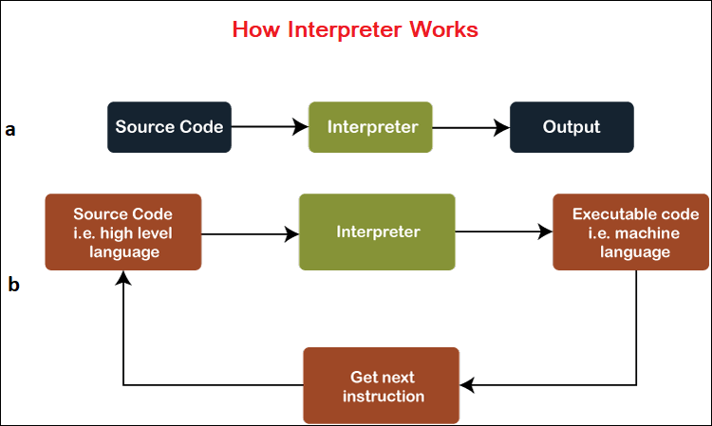

Slide 8
Difference between Compiler and Interpreter:
Parameter | Compiler | Interpreter
Program scanning | Compilers scan the entire program in one go. | The program is interpreted/translated one line at a time.
Error detection | As and when scanning is performed, all the errors are shown in the end together, not line by line. | One line of code is scanned, and errors encountered are shown.
Object code | Compilers convert the source code to object code. | Interpreters do not convert the source code into object code.
Execution time | The execution time of compiler is less, hence it is preferred. | It is not preferred due to its slow speed. Usually, interpreter is slow, and hence takes more time to execute the object code.
Need of source code | Compiler doesn’t require the source code for execution later. | It requires the source code for execution later.
Programming languages | Programming languages that use compilers include C, C++, C#, etc.. | Programming languages that uses interpreter include Python, Ruby, Perl, MATLAB, etc.
Types of errors detected | Compiler can check syntactic and semantic errors in the program simultaneously. | Interpreter checks the syntactic errors only.
Size | Compiler are larger in size. | Interpreters are smaller in size.
Flexibility | Compilers are not flexible. | Interpreters are relatively flexible.
Efficiency | Compilers are more efficient. | Interpreters are less efficient.

Slide 9
Bootstrapping
Bootstrapping is widely used in the compilation development.
Bootstrapping is used to produce a self-hosting compiler. Self-hosting compiler is a type of compiler that can compile its own source code.
Bootstrap compiler is used to compile the compiler and then you can use this compiled compiler to compile everything else as well as future versions of itself.

Slide 10
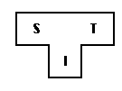
A compiler can be characterized by three languages:
Source Language
Target Language
Implementation Language
The T- diagram shows a compiler ^{S}C_{I}^{T} for Source S, Target T, implemented in I.

Slide 11

Follow some steps to produce a new language L for machine A:
1. Create a compiler ^{S}C_{A}^{A} for subset, S of the desired language, L using language "A" and that compiler runs on machine A.

Slide 12

2. Create a compiler ^{L}C_{S}^{A} for language L written in a subset of L.

Slide 13
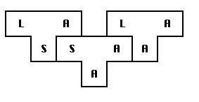
3. Compile ^{L}C_{S}^{A} using the compiler ^{S}C_{A}^{A} to obtain ^{L}C_{A}^{A}. ^{L}C_{A}^{A} is a compiler for language L, which runs on machine A and produces code for machine A.
The process described by the T-diagrams is called bootstrapping.

Slide 14
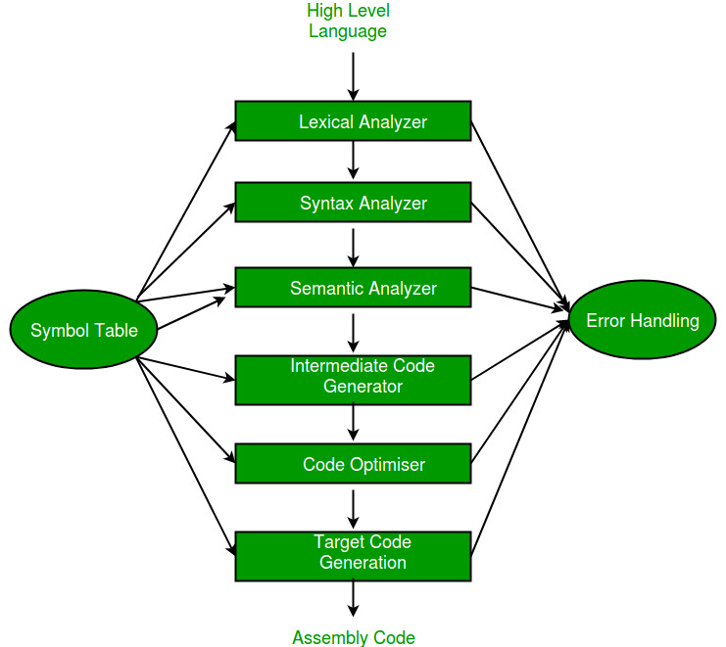
Phases of Compiler

Slide 15
A compiler is a software program that converts the high-level source code written in a programming language into low-level machine code that can be executed by the computer hardware.
The process of converting the source code into machine code involves several phases or stages, which are collectively known as the phases of a compiler.
We basically have two phases of compilers, namely the Analysis phase and Synthesis phase. The analysis phase creates an intermediate representation from the given source code. The synthesis phase creates an equivalent target program from the intermediate representation.

Slide 16
The compiler has two modules namely the front end and the back end. Front-end constitutes the Lexical analyzer, semantic analyzer, syntax analyzer, and intermediate code generator. And the rest are assembled to form the back end.

Slide 17
1. Lexical Analysis: The first phase of a compiler is lexical analysis. It is also called a scanner. This phase reads the source code and breaks it into a stream of tokens, which are the basic units of the programming language. The tokens are then passed on to the next phase for further processing.
2. Syntax Analysis: The second phase of a compiler is syntax analysis. It is sometimes called a parser. It constructs the parse tree. This phase takes the stream of tokens generated by the lexical analysis phase and checks whether they conform to the grammar of the programming language. The output of this phase is usually an Abstract Syntax Tree (AST).

Slide 18
3. Semantic Analysis: The third phase of a compiler is semantic analysis. This phase checks whether the code is semantically correct, i.e., whether it conforms to the language’s type system and other semantic rules. In this stage, the compiler checks the meaning of the source code to ensure that it makes sense. The compiler performs type checking, which ensures that variables are used correctly and that operations are performed on compatible data types. The compiler also checks for other semantic errors, such as undeclared variables and incorrect function calls.

Slide 19
4. Intermediate Code Generator: The fourth phase of a compiler is intermediate code generation. This phase generates an intermediate representation of the source code that can be easily translated into machine code.
5. Code Optimizer: The fifth phase of a compiler is optimization. This phase applies various optimization techniques to the intermediate code to improve the performance of the generated machine code.
6. Code Generator: The final phase of a compiler is code generation. This phase takes the optimized intermediate code and generates the actual machine code that can be executed by the target hardware.

Slide 20
The advantages of using a compiler to translate high-level programming languages into machine code are:
Portability: Compilers allow programs to be written in a high-level programming language, which can be executed on different hardware platforms without the need for modification. This means that programs can be written once and run on multiple platforms, making them more portable.
Optimization: Compilers can apply various optimization techniques to the code, such as loop unrolling, dead code elimination, and constant propagation, which can significantly improve the performance of the generated machine code.
Error Checking: Compilers perform a thorough check of the source code, which can detect syntax and semantic errors at compile-time, thereby reducing the likelihood of runtime errors.
Maintainability: Programs written in high-level languages are easier to understand and maintain than programs written in low-level assembly language. Compilers help in translating high-level code into machine code, making programs easier to maintain and modify.
Productivity: High-level programming languages and compilers help in increasing the productivity of developers. Developers can write code faster in high-level languages, which can be compiled into efficient machine code.

Slide 21
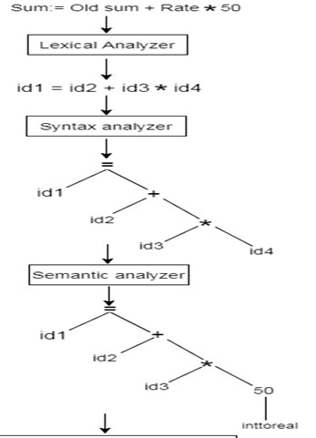
Example:

Slide 22
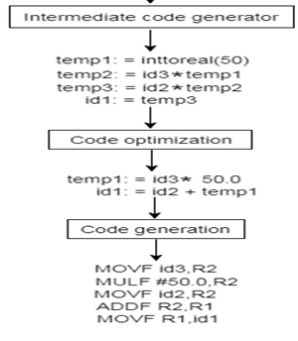

Slide 23
Lexical analysis
Lexical Analysis is the first phase of the compiler also known as a scanner.
The lexical analyzer breaks these syntaxes into a series of tokens, by removing any whitespace or comments in the source code.
If the lexical analyzer finds a token invalid, it generates an error.
It reads character streams from the source code, checks for legal tokens, and passes the data to the syntax analyzer when it demands.

Slide 24
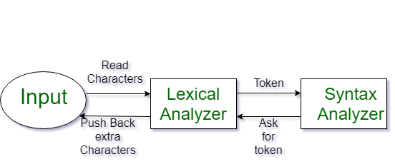
Lexical Analysis can be implemented with the Deterministic finite Automata.
The output is a sequence of tokens that is sent to the parser for syntax analysis.

Slide 25
There are three important terms:
Tokens
Lexemes
Patterns
1. Tokens: A Token is a pre-defined sequence of characters that cannot be broken down further. It is like an abstract symbol that represents a unit. A token can have an optional attribute value. There are different types of tokens:
Identifiers (user-defined)
Delimiters/ punctuations (;, ,, {}, etc.)
Operators (+, -, *, /, etc.)
Special symbols
Keywords
Numbers

Slide 26
2. Lexemes:A lexeme is a sequence of characters matched in the source program that matches the pattern of a token.
Example: (, ) are lexemes of type punctuation where punctuation is the token.
3. Patterns: A pattern is a set of rules a scanner follows to match a lexeme in the input program to identify a valid token.
Example: the characters in the keyword are the pattern to identify a keyword. To identify an identifier the pre-defined set of rules to create an identifier is the pattern

Slide 27
Token | Lexeme | Pattern
Keyword | while | w-h-i-l-e
Relop | < | <, >, >=, <=, !=, ==
Integer | 7 | (0 - 9)*-> Sequence of digits with at least one digit
String | "Hi" | Characters enclosed by " "
Punctuation | , | ; , . ! etc.
Identifier | number | A - Z, a - z A sequence of characters and numbers initiated by a character.

Slide 28
 | Token | Lexeme | Pattern
 | Token is basically a sequence of characters that are treated as a unit as it cannot be further broken down. | It is a sequence of characters in the source code that are matched by given predefined language rules for every lexeme to be specified as a valid token. | It specifies a set of rules that a scanner follows to create a token.
 | all the reserved keywords of that language(main, printf, etc.) | int, goto | The sequence of characters that make the keyword.
 | name of a variable, function, etc | main, a | it must start with the alphabet, followed by the alphabet or a digit.
 | all the operators are considered tokens. | +, = | +, =
 | each kind of punctuation is considered a token. e.g. semicolon, bracket, comma, etc. | (, ), {, } | (, ), {, }
 | a grammar rule or boolean literal. | “Welcome to GeeksforGeeks!” | any string of characters (except ‘ ‘) between ” and “

Slide 29
Role of Lexical Analyzer:
The lexical analysis is the first phase of the compiler where a lexical analyser operate as an interface between the source code and the rest of the phases of a compiler.
It reads the input characters of the source program, groups them into lexemes, and produces a sequence of tokens for each lexeme. The tokens are sent to the parser for syntax analysis.
If the lexical analyzer is located as a separate pass in the compiler it can need an intermediate file to locate its output, from which the parser would then takes its input.
It can eliminate the need for the intermediate file, the lexical analyzer and the syntactic analyser (parser) are often grouped into the same pass where the lexical analyser operates either under the control of the parser or as a subroutine with the parser.

Slide 30
The lexical analyzer also interacts with the symbol table while passing tokens to the parser.
Whenever a token is discovered, the lexical analyzer returns a representation for that token to the parser. If the token is a simple construct including parenthesis, comma, or a colon, then it returns an integer program. If the token is a more complex items including an identifier or another token with a value, the value is also passed to the parser.
Lexical analyzer separates the characters of the source language into groups that logically belong together, called tokens.
It includes the token name which is an abstract symbol that define a type of lexical unit and an optional attribute value called token values. Tokens can be identifiers, keywords, constants, operators, and punctuation symbols including commas and parenthesis. A rule that represent a group of input strings for which the equal token is make as output is called the pattern.

Slide 31
The lexical analyzer also handles issues including stripping out the comments and whitespace (tab, newline, blank, and other characters that are used to separate tokens in the input).
The correlating error messages that are generated by the compiler during lexical analyzer with the source program.
For example, it can maintain track of all newline characters so that it can relate an ambiguous statement line number with each error message.
It can be implementing the expansion of macros, in the case of macro, pre-processors are used in the source program.

Slide 32
Input Buffering
The lexical analyzer scans the input from left to right one character at a time. It uses two pointers begin ptr(bp) and forward ptr(fp) to keep track of the pointer of the input scanned.
Input buffering is an important concept in compiler design that refers to the way in which the compiler reads input from the source code. In many cases, the compiler reads input one character at a time, which can be a slow and inefficient process.
Input buffering is a technique that allows the compiler to read input in larger chunks, which can improve performance and reduce overhead.

Slide 33
For example, if the size of the buffer is too large, it may consume too much memory, leading to slower performance or even crashes. Additionally, if the buffer is not properly managed, it can lead to errors in the output of the compiler.
Overall, input buffering is an important technique in compiler design that can help improve performance and reduce overhead. However, it must be used carefully and appropriately to avoid potential problems.

Slide 34
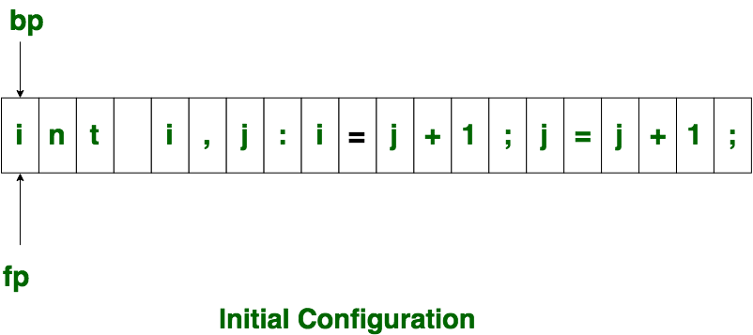
Initially both the pointers point to the first character of the input string as shown below

Slide 35
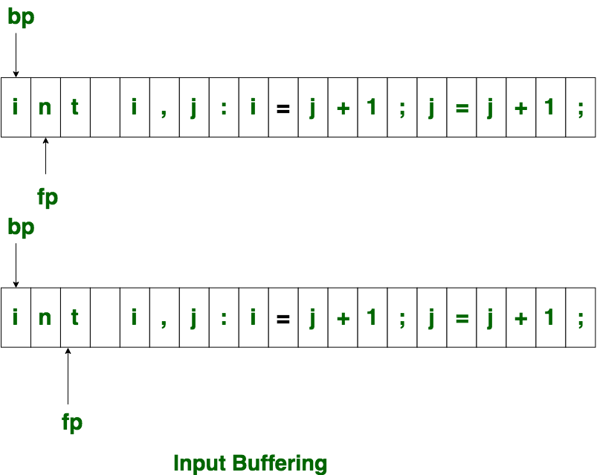

Slide 36
The forward ptr moves ahead to search for end of lexeme. As soon as the blank space is encountered, it indicates end of lexeme.
In above example as soon as ptr (fp) encounters a blank space the lexeme “int” is identified. The fp will be moved ahead at white space, when fp encounters white space, it ignore and moves ahead. then both the begin ptr(bp) and forward ptr(fp) are set at next token.
The input character is thus read from secondary storage, but reading in this way from secondary storage is costly. hence buffering technique is used.
A block of data is first read into a buffer, and then second by lexical analyzer. there are two methods used in this context: One Buffer Scheme, and Two Buffer Scheme. These are explained as following below.

Slide 37
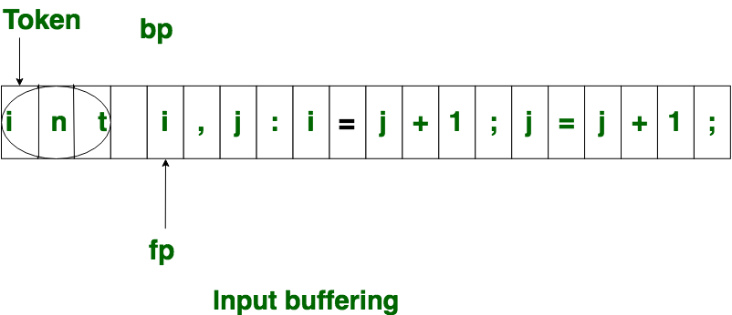

Slide 38
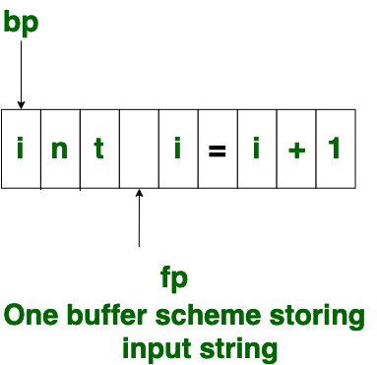
One Buffer Scheme: In this scheme, only one buffer is used to store the input string but the problem with this scheme is that if lexeme is very long then it crosses the buffer boundary, to scan rest of the lexeme the buffer has to be refilled, that makes overwriting the first of lexeme.

Slide 39
Two Buffer Scheme:
To overcome the problem of one buffer scheme, in this method two buffers are used to store the input string. the first buffer and second buffer are scanned alternately.
When end of current buffer is reached the other buffer is filled. the only problem with this method is that if length of the lexeme is longer than length of the buffer then scanning input cannot be scanned completely. Initially both the bp and fp are pointing to the first character of first buffer.

Slide 40
Then the fp moves towards right in search of end of lexeme. as soon as blank character is recognized, the string between bp and fp is identified as corresponding token. to identify, the boundary of first buffer end of buffer character should be placed at the end first buffer.
Similarly end of second buffer is also recognized by the end of buffer mark present at the end of second buffer. when fp encounters first eof, then one can recognize end of first buffer and hence filling up second buffer is started.

Slide 41
In the same way when second eof is obtained then it indicates of second buffer. alternatively both the buffers can be filled up until end of the input program and stream of tokens is identified.
This eof character introduced at the end is calling Sentinel which is used to identify the end of buffer.

Slide 42
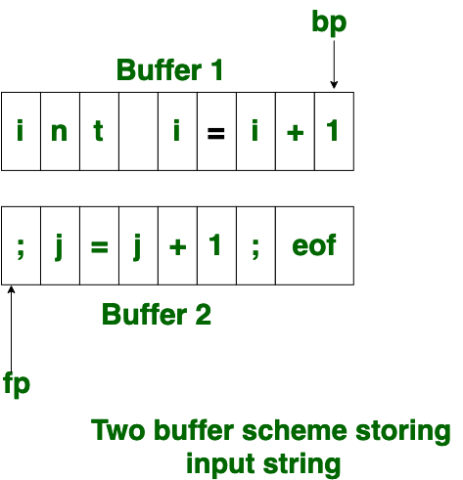

Slide 43
Specification of tokens
There are 3 specifications of tokens: 1. String
2. Language
3. Regular Expression
1. String:
An alphabet or character class is a finite set of symbols.
A string over an alphabet is a finite sequence of symbols drawn from that alphabet.
The length of a string s, usually written |s|, is the number of occurrences of symbols in s. For example, "banana" is a string of length six.
The empty string, denoted ε, is the string of length zero.

Slide 44
Operations on String:
1. Prefix of String
The prefix of the string is the preceding symbols present in the string and the string(s) itself.
Example: s = abcd
The prefix of the string abcd: ∈, a, ab, abc, abcd 2. Suffix of String
Suffix of the string is the ending symbols of the string and the string(s) itself.
Example: s = abcd
Suffix of the string abcd: ∈, d, cd, bcd, abcd

Slide 45
3. Proper Prefix of String
The proper prefix of the string includes all the prefixes of the string excluding ∈ and the string(s) itself.
Proper Prefix of the string abcd: a, ab, abc 4. Proper Suffix of String The proper suffix of the string includes all the suffixes excluding ∈ and the string(s) itself. Proper Suffix of the string abcd: d, cd, bcd

Slide 46
5. Substring of String The substring of a string s is obtained by deleting any prefix or suffix from the string. Substring of the string abcd: ∈, abcd, bcd, abc, …
6. Proper Substring of String The proper substring of a string s includes all the substrings of s excluding ∈ and the string(s) itself. Proper Substring of the string abcd: bcd, abc, cd, ab…

Slide 47
7. Subsequence of String The subsequence of the string is obtained by eliminating zero or more (not necessarily consecutive) symbols from the string. A subsequence of the string abcd: abd, bcd, bd, … 8. Concatenation of String If s and t are two strings, then st denotes concatenation. s = abc t = def Concatenation of string s and t i.e. st = abcdef

Slide 48
2. Language: A language is any countable set of strings over some fixed alphabet.
Operation on Language
As we have learnt language is a set of strings that are constructed over some fixed alphabets. Now the operation that can be performed on languages are:
1. Union Union is the most common set operation. Consider the two languages L and M. Then the union of these two languages is denoted by:
L ∪ M = { s | s is in L or s is in M}
That means the string s from the union of two languages can either be from language L or from language M. If L = {a, b} and M = {c, d} Then L ∪ M = {a, b, c, d}

Slide 49
2. Concatenation Concatenation links the string from one language to the string of another language in a series in all possible ways. The concatenation of two different languages is denoted by: L ⋅ M = {st | s is in L and t is in M} If L = {a, b} and M = {c, d} Then L ⋅ M = {ac, ad, bc, bd} 3. Kleene Closure Kleene closure of a language L provides you with a set of strings. This set of strings is obtained by concatenating L zero or more time. The Kleene closure of the language L is denoted by: If L = {a, b} then L* = {∈, a, b, aa, bb, aaa, bbb, …}

Slide 50
4. Positive Closure The positive closure on a language L provides a set of strings. This set of strings is obtained by concatenating ‘L’ one or more times. It is denoted by:
It is similar to the Kleene closure. Except for the term L⁰, i.e. L⁺ excludes ∈ until it is in L itself. If L = {a, b} then L+ = {a, b, aa, bb, aaa, bbb, …} So, these are the four operations that can be performed on the languages in the lexical analysis phase.

Slide 51
3. Regular Expression: A regular expression is a sequence of symbols used to specify lexeme patterns. A regular expression is helpful in describing the languages that can be built using operators such as union, concatenation, and closure over the symbols.
A regular expression ‘r’ that denotes a language L(r) is built recursively over the smaller regular expression using the rules given below. The following rules define the regular expression over some alphabet Σ and the languages denoted by these regular expressions.
∈ is a regular expression that denotes a language L(∈). The language L(∈) has a set of strings {∈} which means that this language has a single empty string.
If there is a symbol ‘a’ in Σ then ‘a’ is a regular expression that denotes a language L(a). The language L(a) = {a} i.e. the language has only one string of length one and the string holds ‘a’ in the first position.
Consider the two regular expressions r and s then:
r|s denotes the language L(r) ∪ L(s).
(r) (s) denotes the language L(r) ⋅ L(s).
(r)* denotes the language (L(r))*.
(r)+ denotes the language L(r).

Slide 52
Recognition of Tokens
As we know Lexical Analyzer reads our source program character by character and produces a stream of tokens.
Here Token may be an Identifier such as variable or operator or constant or keyword.
Tokens are specified with the help of Regular Expressions and after that we have to recognize the tokens with the help of Transition Diagrams.

Slide 53
Example:
Recognition of identifiers
Recognition of delimiter
Recognition of relational operators
Recognition of keywords such as if, else, for……
Recognition of numbers (int | float,….)

Slide 54
Recognition of identifiers
Letter → a|b|c…..z
A|B|C…..Z
Digit → 0|1|2…9
R.E:
Id → letter(letter|digit)*
Letter/digit
q0
letter
q1
q1
Ex: abc12ab,a43,Aa2aZ……

Slide 55
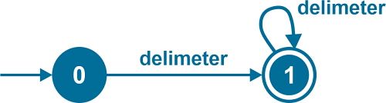
2. Recognition of delimiter
There are different types of delimiters like white space, newline character, tab space, etc.
Delimiter -> ' ', '\t', '\n'
R.E:
ws → delimeter(delimiter)*

Slide 56
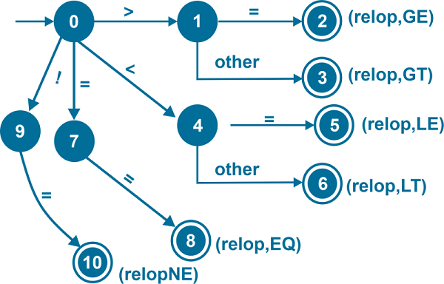
3. Recognition of relational operators
GE: Greater than or equal to
LE: Less than or equal to
GT: Greater than
LT: Less than
EQ: Equals to
NE: Not equal to

Slide 57
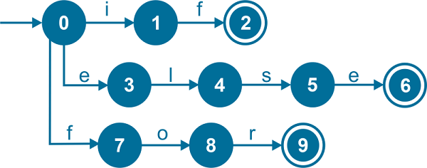
4. Recognition of keywords
Identifies if, else, and for. As mentioned earlier, a keyword's letters are the pattern to identify a keyword.

Slide 58
5. Recognition of numbers
A number can be in the form of:
A whole number (0, 1, 2...)
A decimal number (0.1, 0.2...)
Scientific notation(1.25E), (1.25E23)
Regular grammar:
Digit -> 0|1|....9
Digits -> Digit (Digit)*
Number -> Digits (.Digits)? (E[+ -] ? Digits)?

Slide 59
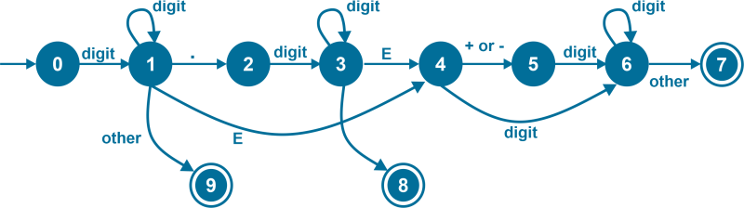
Number -> Digits (.Digits)? (E[+ -] ? Digits)?

Slide 60
A language for specifying lexical analyzers
There is a wide range of tools for constructing lexical analyzers.
1. Lex
2. YACC
Lex is a computer program that generates lexical analyzers. Lex is commonly used with the yacc parser generator.
Creating a lexical analyzer
•First, a specification of a lexical analyzer is prepared by creating a program lex.l in the Lex language.
Then, lex.l is run through the Lex compiler to produce a C program lex.yy.c.
•Finally, lex.yy.c is run through the C compiler to produce an object program a.out, which is the lexical analyzer that transforms an input stream into a sequence of tokens.

Slide 61
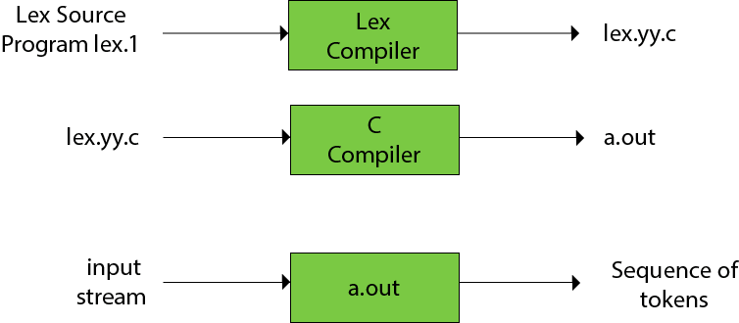
Lex file format
A Lex program is separated into three sections by %% delimiters. The format of Lex source is as follows:
{ definitions }
%%
{ rules }
%%
{ user subroutines }

Slide 62
Definitions include declarations of constant, variable and regular definitions.
Rules define the statement of form p1 {action1} p2 {action2}....pn {action}.
Where pi describes the regular expression and action1 describes the actions what action the lexical analyzer should take when pattern pi matches a lexeme.
User subroutines are auxiliary procedures needed by the actions. The subroutine can be loaded with the lexical analyzer and compiled separately.

Slide 63
The following Lex Program counts the number of words-
%{
#include<stdio.h>
#include<string.h>
int count = 0;
%}
/* Rules Section*/
%%
([a-zA-Z0-9])* {count++;}
"\n"{printf("Total Number of Words : %d\n", count); count = 0;}
%%
int yywrap(void){}
int main()
{
yylex();
return 0;
}
How to execute
Type lex lexfile.l
Type gcc lex.yy.c.
Type ./a.exe

